Slide 1
Analysis of Algorithms and Complexity Theory
To analyze performance of different algorithmic strategies in terms of time and space.
To develop time and space efficient algorithms
Analyze the asymptotic performance of algorithms

Slide 2
Analysis
Input Size:
Input size (number of elements in the input)
Running time depends on input size
Measure time efficiency as function of input size
Different input of size n may take a different amount of time

Slide 3
How do we determine the input size?
A natural parameter
For sorting and other problems on array: Array size
For combinational problems: No of objects
For graphs: no of vertices and edges
Note: Important is class of problem

Slide 4
CONT..
The compile time does not depend on the instance characteristics. But run time is depending on the instance characteristics.
f(n) :Where n denotes the instance characteristics

Slide 5
Types of Analysis
The field of computer science, which studies efficiency of algorithms, is known as analysis of algorithms.
The function f(n), gives the running time of an algorithm, depends not only on the size ‘n’ of the input data but also on the particular data. The complexity function f(n) for certain cases are:
Best Case : The minimum possible value of f(n) is called the best case.
Provides a lower bound on running time
Input is the one for which the algorithm runs the fastest

Slide 6
Cont…
2. Worst Case : The maximum value of f(n) for any key possible input.
Provides an upper bound on running time
An absolute guarantee that the algorithm would not run longer, no matter what the inputs are

Slide 7
Cont…
2. Average Case : The expected value of f(n).
Provides a prediction about the running time
Assumes that the input is random
The number of executed count of the dominant operations is used to estimate the running time.

Slide 8
Cont..
Express running time as a function of the input size n (i.e., f(n)).
Compare different functions corresponding to running times.
Such an analysis is independent of machine time, programming style, etc.
Example: Linear Search

Slide 9
Rate of Growth
It is defined as the rate at which running time increases as a function of input.
Example 1:
If price of lemon=10rs
Price of apple=100rs
Total price~100rs
Example 2:
Let cost of function f= n^8, n^6, n^3: Highest value is n^8 i.e. rate of growth

Slide 10
Asymptotic Growth
It is mathematical way of representing the time complexity.
To compare two algorithms with running times f(n) and g(n), we need a rough measure that characterizes how fast each function grows. [Use rate of growth]
Compare functions in the limit, that is, asymptotically!
(i.e., for large values of n)

Slide 11
Asymptotic Notation
O notation: asymptotic “less than”:
f(n)=O(g(n)) implies: f(n) “≤” g(n)
Ω notation: asymptotic “greater than”:
f(n)= Ω (g(n)) implies: f(n) “≥” g(n)
Θ notation: asymptotic “equality”:
f(n)= Θ (g(n)) implies: f(n) “=” g(n)

Slide 12
Big-O Notation
We say f_{A}(n)=30n+8 is order n, or O (n) It is, at most, roughly proportional to n.
f_{B}(n)=n²+1 is order n², or O(n²). It is, at most, roughly proportional to n².
In general, any O(n²) function is faster- growing than any O(n) function.

Slide 13
Visualizing Orders of Growth
On a graph, as you go to the right, a faster growing function eventually becomes larger...
f_{A}(n)=30n+8
Value of function →
f_{B}(n)=n²+1
Increasing n →

Slide 14
Examples
n⁴ + 100n² + 10n + 50 is O(n⁴)
10n³ + 2n² is O(n³)
n³ - n² is O(n³)
constants
10 is O(1)
1273 is O(1)

Slide 15
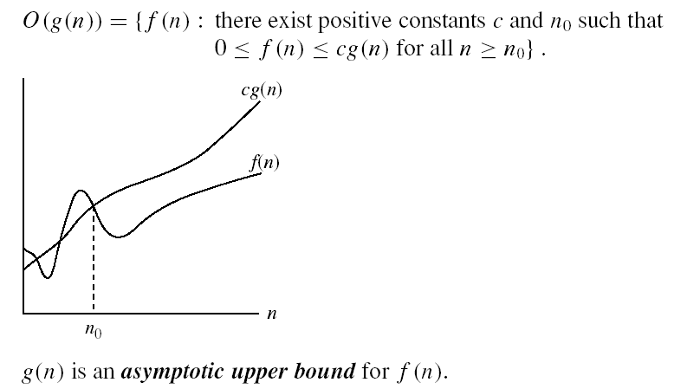
Big Oh Notation

Slide 16
More Examples
f(n)=Og(n)
f(n)<=c*g(n)
Let f(n)=2n+3
1. 2n+3<=10n ; True ,n>=1 : f(n)=O(n)
2. 2n+3<=2n+3n=5n ; True, n>=1 : f(n)=O(n)
3. 2n+3<=2n^2+3n^2=5n ^2 ; True, n>=1 : f(n)=O(n^2)
If g(n)=log n then , f(n)=O(log n); not true
So closest func for Big O is f(n)=O(n)

Slide 17
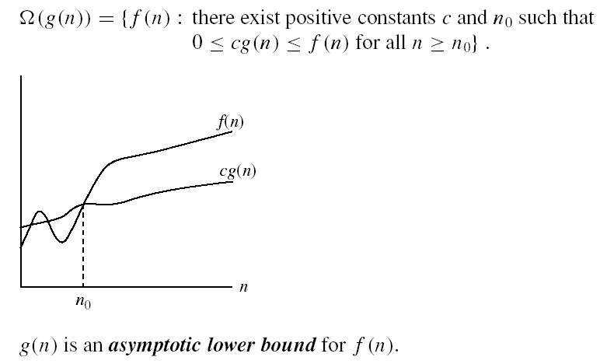
Ω - notation

Slide 18
Examples
f(n)= Ω g(n)
f(n)>=c*g(n)
Let f(n)=2n+3
1. 2n+3>=1n ; True ,n>=1 : f(n)= Ω(n)
2. 2n+3>=log n ; True, n>=1 : f(n)= Ω(log n)
If g(n)= n^2 then , f(n)= Ω( n^2); not true
So closest func for Big Ω is f(n)= Ω(n)

Slide 19

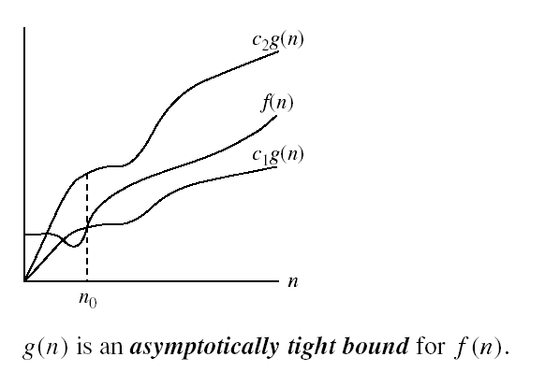
Θ-notation
Θ-notation
Θ(g(n)) is the set of functions with the same order of growth as g(n)

Slide 20
Examples
f(n)= Θ g(n)
C1*g(n)<=f(n)<=c2*g(n)
Let f(n)=2n+3
1*n<= 2n+3<=5n ; True ,n>=1 : f(n)= Θ(n)
If g(n)= n^2 then , f(n)= Θ( n^2); not true
If g(n)= log n then , f(n)= Θ( log n); not true
So func is exact equal to f(n)= Θ(n)

Slide 21
Little o
We use o-notation to denote an upper bound that is not asymptotically tight
We formally define o.g.n// (“little-oh of g of n”) as the set
o.g.n// D ff .n/ W for any positive constant c>0, there exists a constant n0 > 0 such that 0 f .n/ < cg.n/ for all n n0g :

Slide 22
polynomial and non-polynomial problems
Polynomial Time Problems: Linear search :n, Binary search: log n, Selection sort:n^2, Merge sort: n log n, matrix multiplication: n^3
Decision Problem: Any problem for which the answer is either 0 or 1 is called as decision problem.
An algorithm for a decision problem is termed as decision algorithm
Optimization Problem: Any problem that involves the identification of an optimal (either min or max) value of a given cost function is known as Optimization Problem.

Slide 23
Deterministic Algorithm
The notion of algorithms that we have been using has the property that the result of every operation is uniquely defined. Algorithm with this property are termed as Deterministic Algorithm.
It Can determine the next step of execution.
It Can solve the problem in polynomial time.
Ex : Find max no from the inputs: 2, 5, 1, 8 , 3,10

Slide 24
Non Deterministic Algorithm
Can’t solve the problem in polynomial time.
Cannot determine the next step of execution due to more than one path the algorithm can take.
Ex1: Find number from 2 to 8
It is difficult to find which number we have to take, it may be 2, 3, 7 8.
Ex 2: TSP

Slide 25
Cont..
NDC Algorithm:
some of the terms related to the non-deterministic algorithm are defined below:
1. choice(X) : chooses any value randomly from the set X.
2. failure() : denotes the unsuccessful solution.
3. success() : Solution is successful and current thread terminates.

Slide 26
Consider the problem of searching for an element x in a given set of elements A[1:n]
A. Non Deterministic search
1.j= choice(a, n)
2.if(A[j]==x) then { write(j); success(); }
3.write(0); failure();
B. Non deterministic sort

Slide 27
Computational Complexity Problems
1. P Class
2. NP Class : NP Hard and NP complete
P Class: It consists of those problems that are solvable in polynomial time i.e. that can be solved in time 0(n^k) for some constant k, where n is the size of input to the problem.
Examples: Searching, sorting etc.
Or P is a set of all decision problems solvable by deterministic algorithms in polynomial time.

Slide 28
NP
NP is not the same as non-polynomial complexity/running time. NP does not stand for not polynomial.
NP = Non-Deterministic polynomial time
NP means verifiable in polynomial time
Verifiable?
If we are somehow given a ‘certificate’ of a solution we can verify the legitimacy in polynomial time
Or NP is the set of all decision problems solvable by non deterministic algorithms in polynmial time.

Slide 29
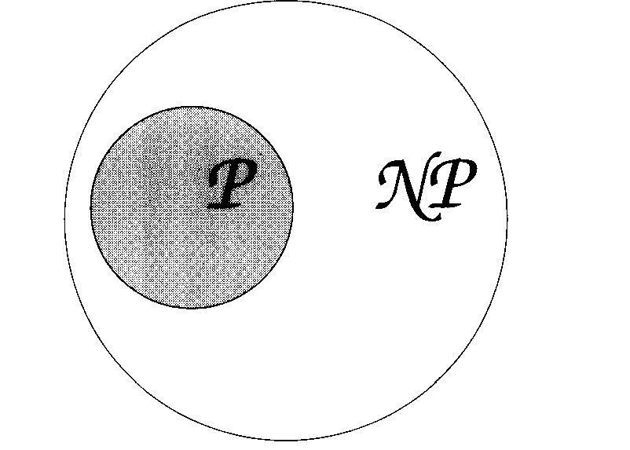
Relationship between P and NP
P problems: sorting, prime no or not etc
NP problems: TSP, Chess game etc.

Slide 30
Polynomial time reduction
Let L1 &L2 be problems. Problem L1 reduce to L2(L1 ∝ L2) if and only if there is a way to solve L1 by a deterministic polynomial time algorithm using deterministic algorithm that solves L2 in polynomial time.

Slide 31
NP Complete
A problem is NP Complete if it is
1. NP Hard problem
2. NP Problem
It has property that it can be solved in polynomial time if and only if all other NP Complete problems can be solved in polynomial time.

Slide 32
Vertex Cover
Given an undirected graph G = (V, E) and an integer k, is there a subset of vertices S ⊆ V such that |S| ≤ k, and if (v, w) ∈ E then either v ∈ S, w ∈ S or both.
Ex. Is there a vertex cover of size 4?
1
6
6
2
7
7
3
3
8
4
9
5
10
10
32

Slide 33
Example: Clique
CLIQUE = { <G,k> | G is a graph with a clique of size k }
A clique is a subset of vertices that are all connected
Why is CLIQUE in NP?

Slide 34
3-SAT
3-SAT = { f | f is in Conjunctive Normal Form, each clause has exactly 3 literals and f is satisfiable }
3-SAT is NP-Complete
(2-SAT is in P)

Slide 35
NP-Completeness Proof Method
To show that Q is NP-Complete:
1) Show that Q is in NP
2) Pick an instance, R, of your favorite NP-Complete problem (ex: Φ in 3-SAT)
3) Show a polynomial algorithm to transform R into an instance of Q

Slide 36
NP HARD
If an NP Hard problem can be solved in polynomial time then all NP Complete problems can be solved in polynomial time.
All NP Complete problems are NP Hard but some NP Hard problems are not known to be NP Complete.
It is easy to see that there are NP Hard problems that are not NP Complete. However an optimization problems may be NP Hard.
Example
Some languages L are so hard that although we can prove of the definition of NP completeness and if we can not prove the condition i.e., L is in NP. I f so we call L is NP Hard.

Slide 37
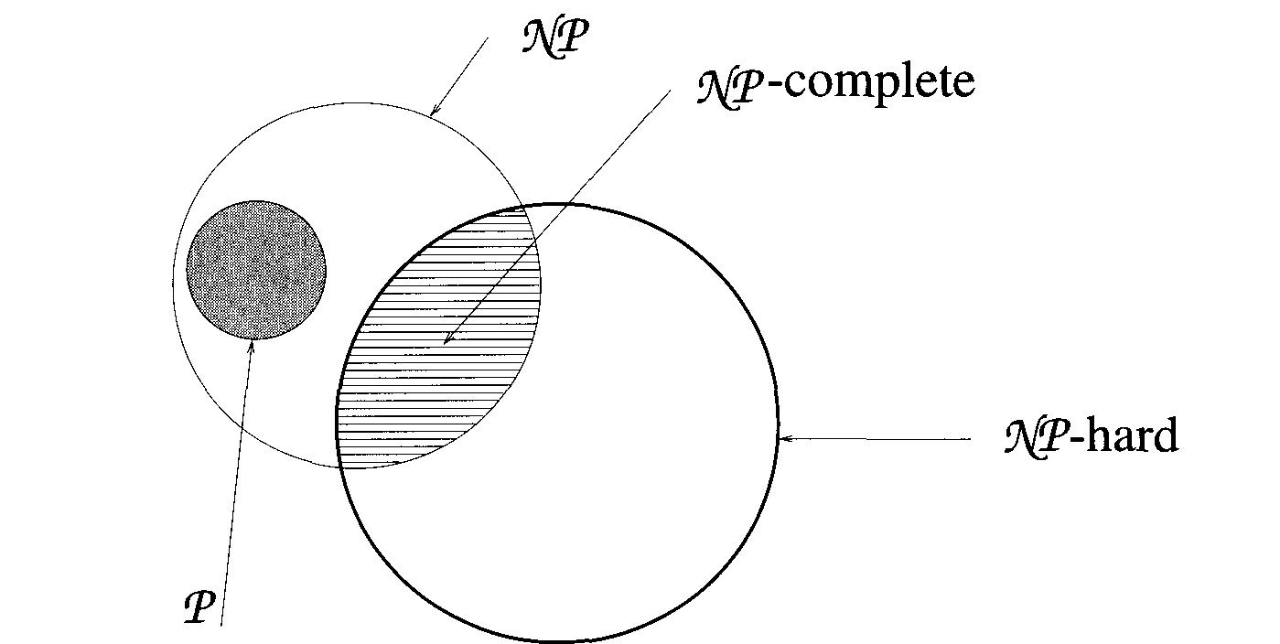
Relationship among P, NP, NP Hard and NP Complete

Slide 38
Questions?

